Slide 1
Manuscript Final Figures

Slide 2
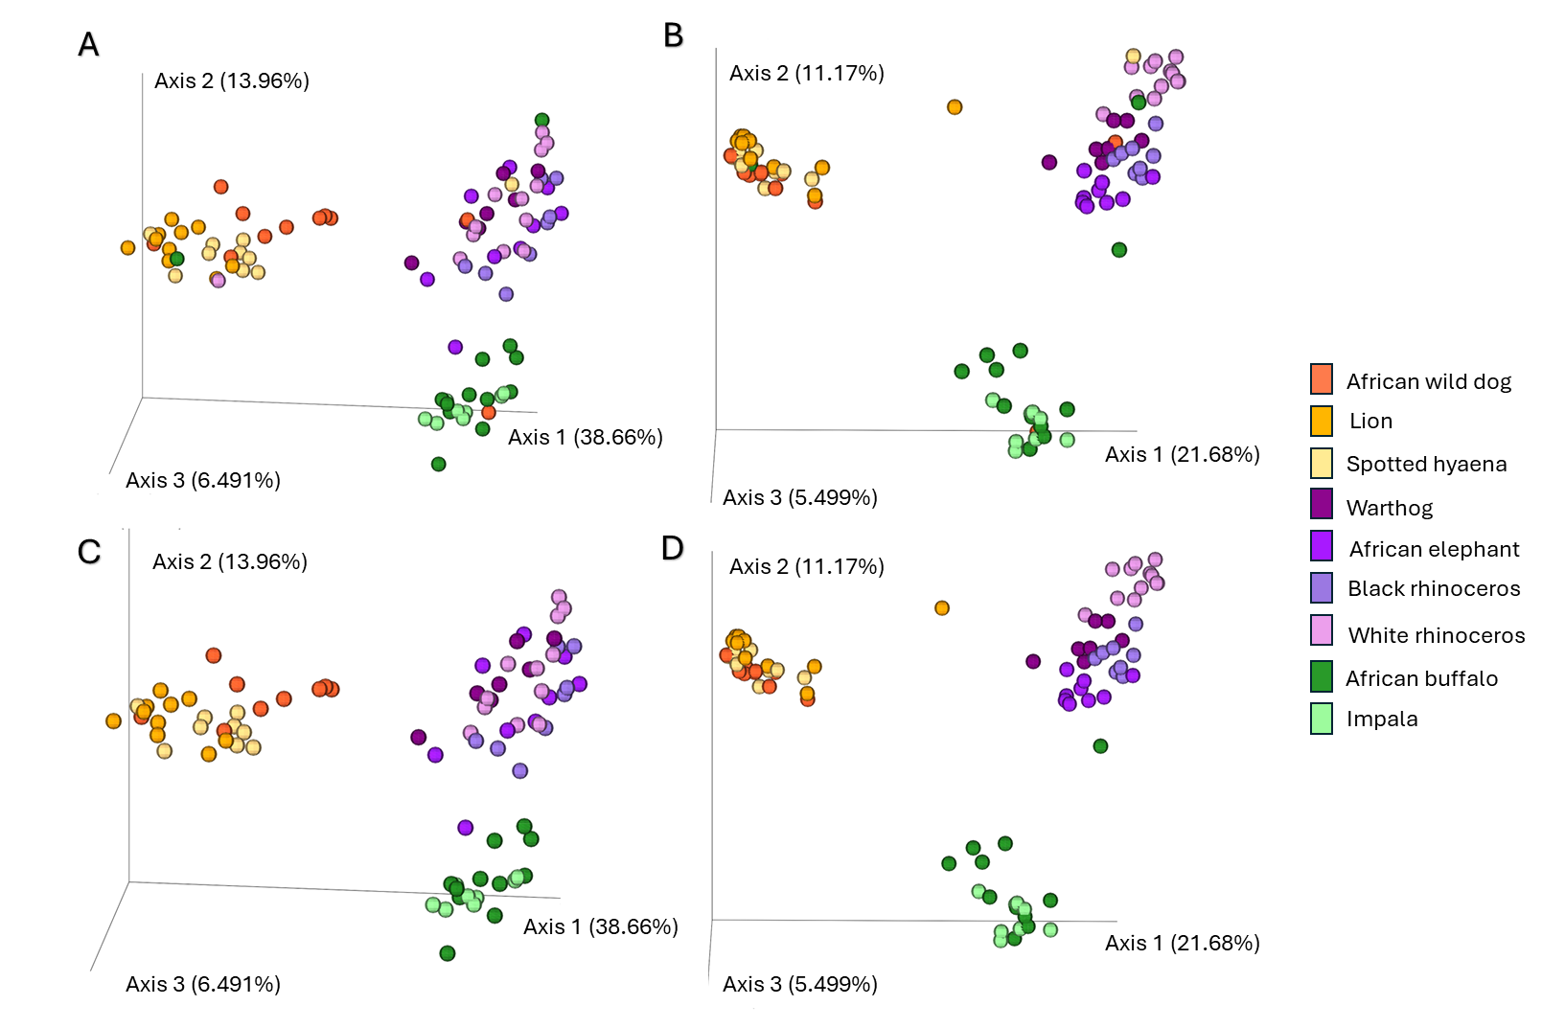

Slide 3
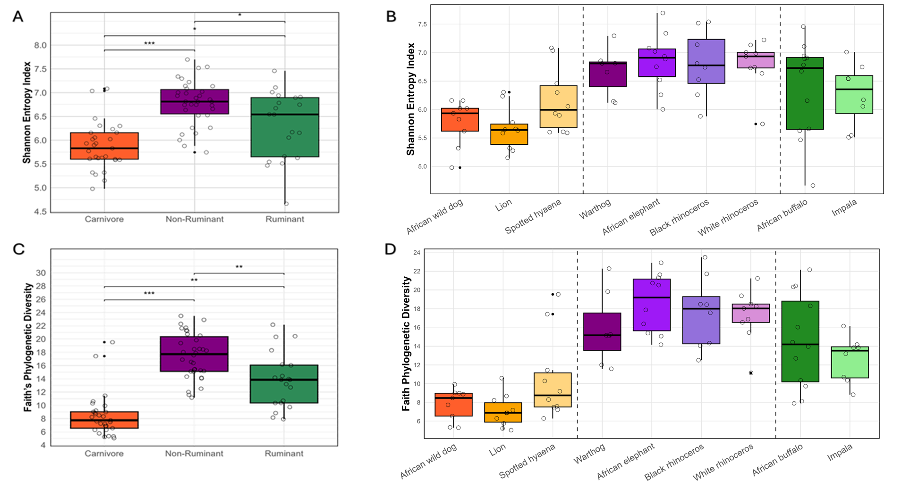

Slide 4
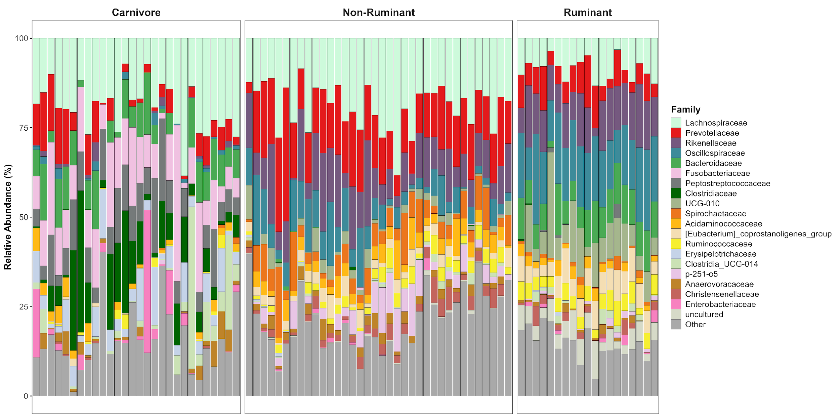

Slide 5
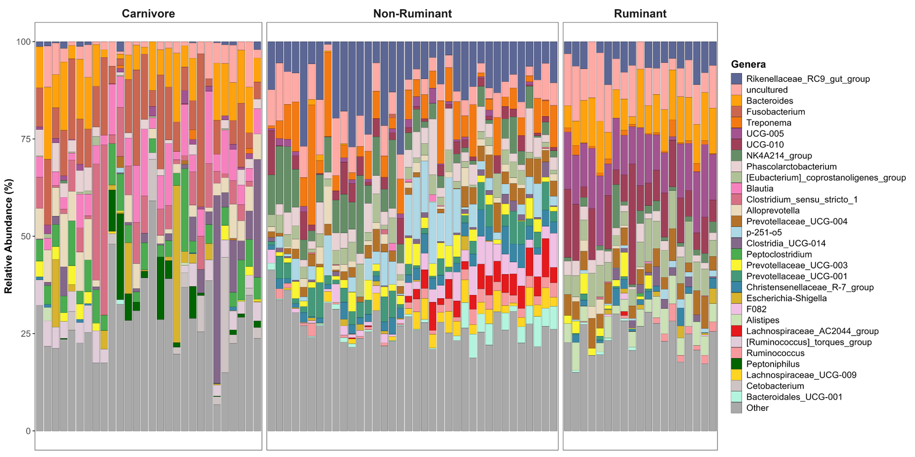

Slide 6
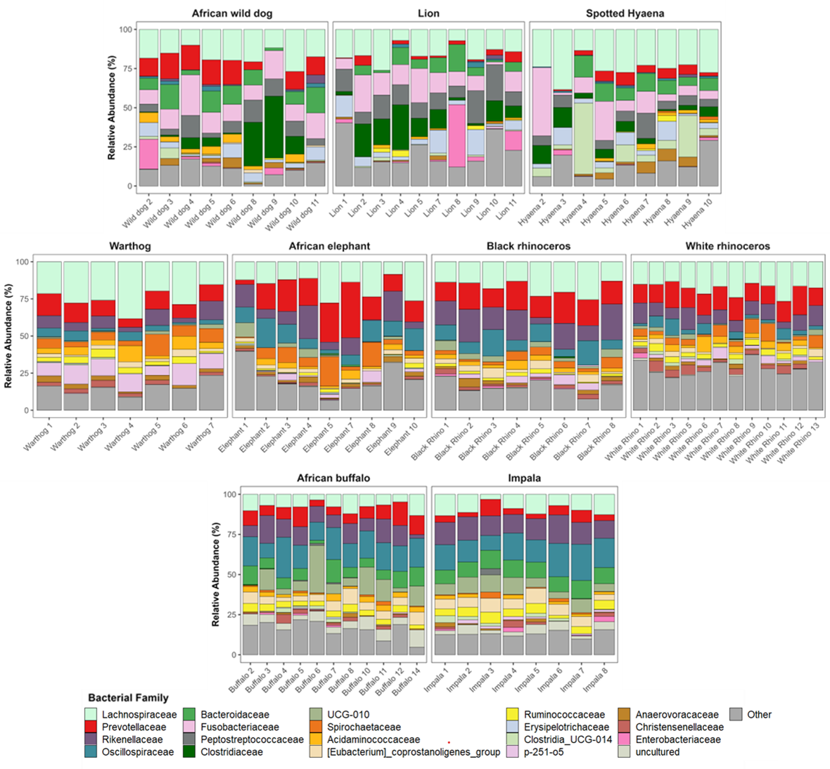

Slide 7
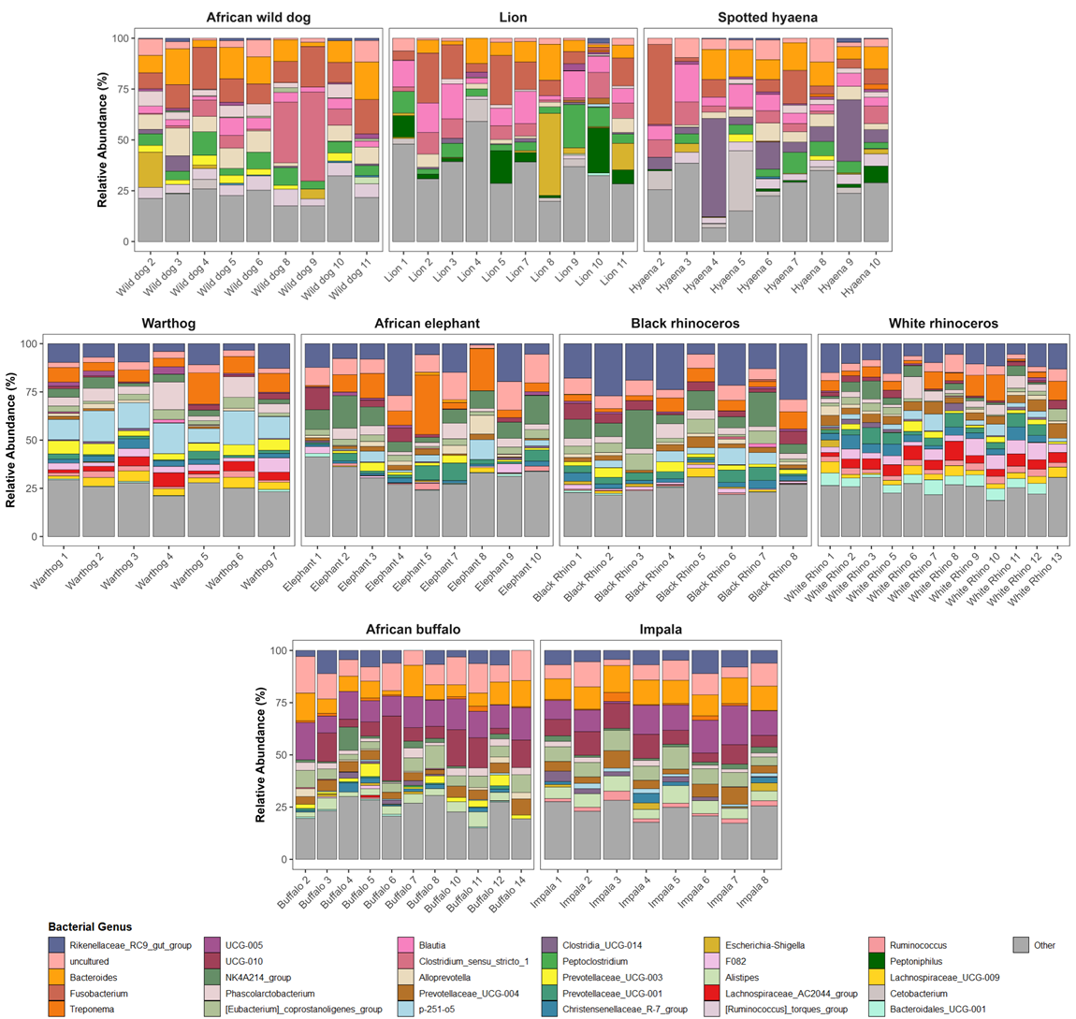

Slide 8
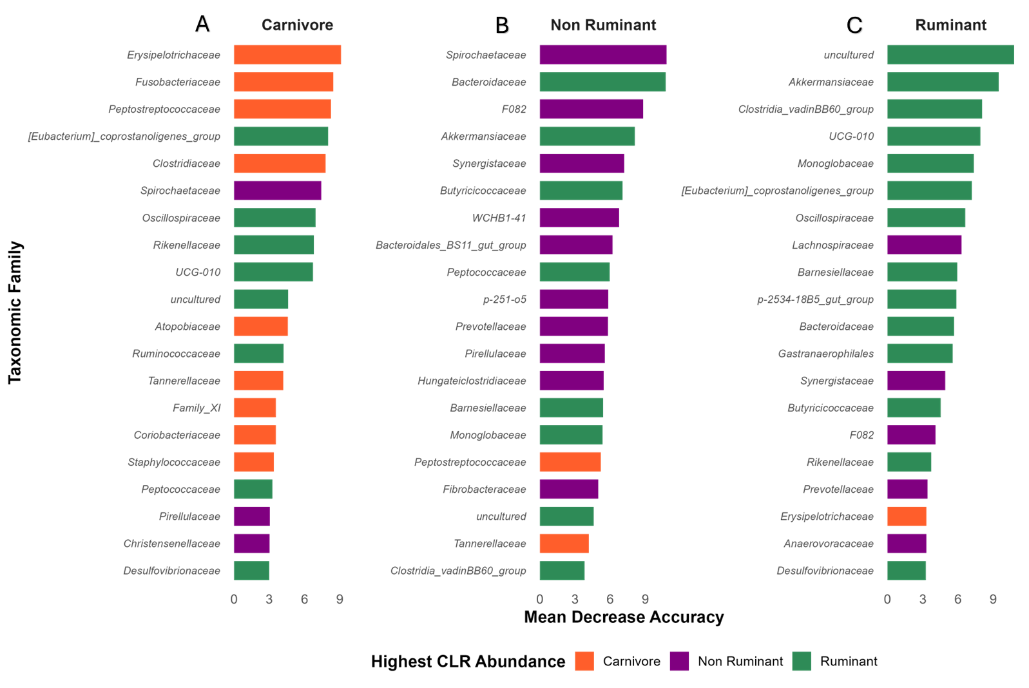

Slide 9
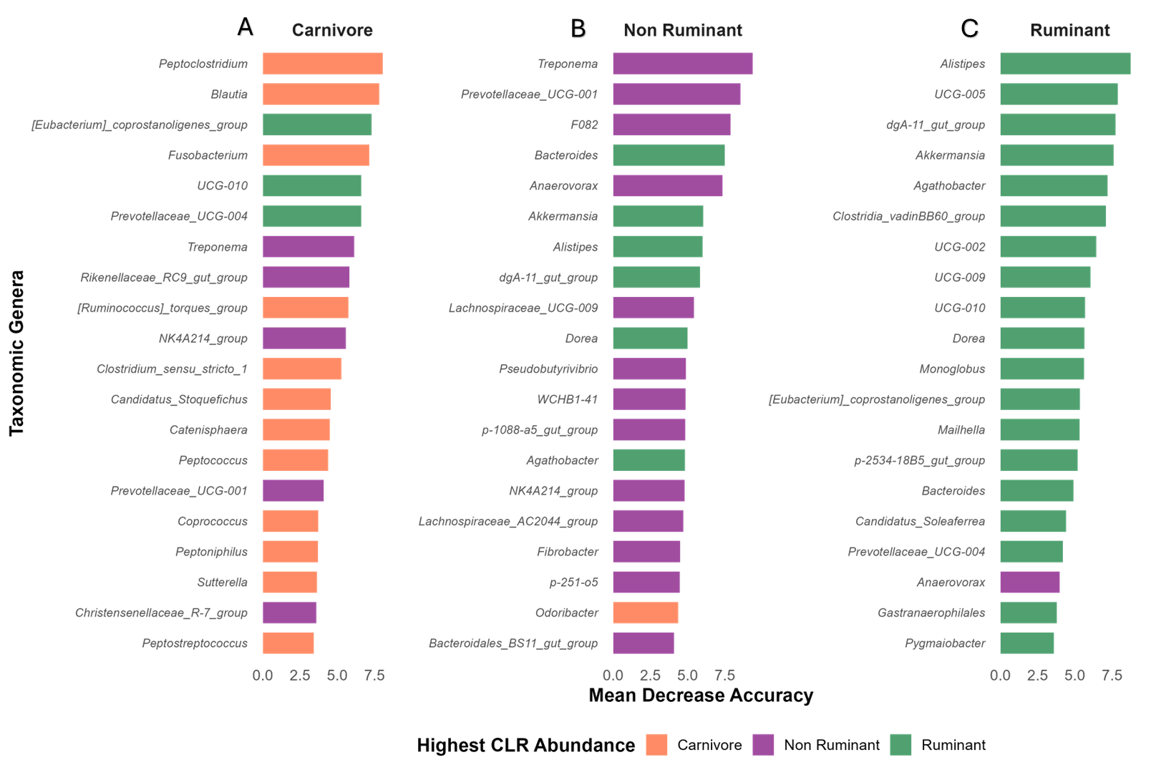

Slide 10
Supplementary Material

Slide 11
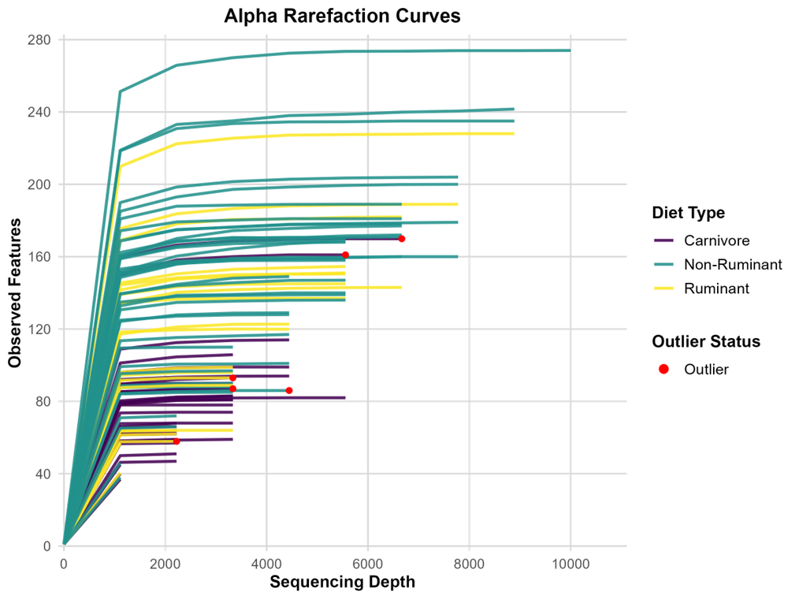
Notes:
Figure S1. Alpha Rarefaction Curves of Microbial Communities Stratified by Diet Type. Alpha rarefaction curves depicting the observed features (species richness) across varying sequencing depths for each sample. Each line represents a sample, coloured by its corresponding diet type (purple, teal, yellow). Red dots indicate observed outliers from Beta diversity PCAo plots. Rarefaction analysis was performed using QIIME 2 to evaluate sampling depth adequacy and community diversity saturation across samples. Plateaus in the curves suggest sufficient sampling depth for most samples.

Slide 12
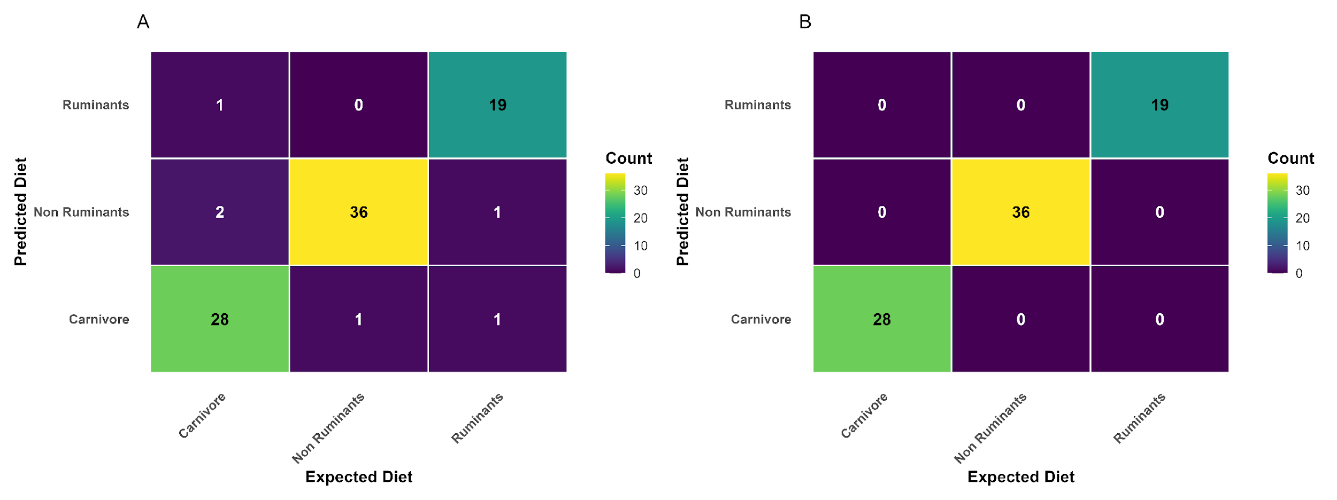
Notes:
Figure S2. Random Forest classification of gut microbiota by dietary group.

Slide 13
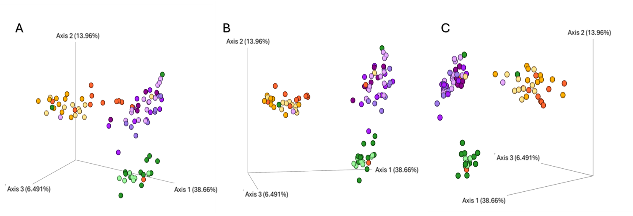
Notes:
Figure S2. Principal Coordinate Analysis (PCoA) of Weighted UniFrac distances from microbial community profiles, shown from multiple perspectives. Panels A, B, and C depict the same PCoA ordination generated using Weighted UniFrac distances, visualized through the Emperor software but viewed from distinct angles to provide comprehensive spatial representation of sample clustering. Each point corresponds to an individual sample, and the relative distances between points reflect differences in microbial community composition based on presence or absence of taxa. These alternative views highlight the robustness of sample separation patterns and confirm consistent clustering across multiple dimensions in the ordination space.

Slide 14
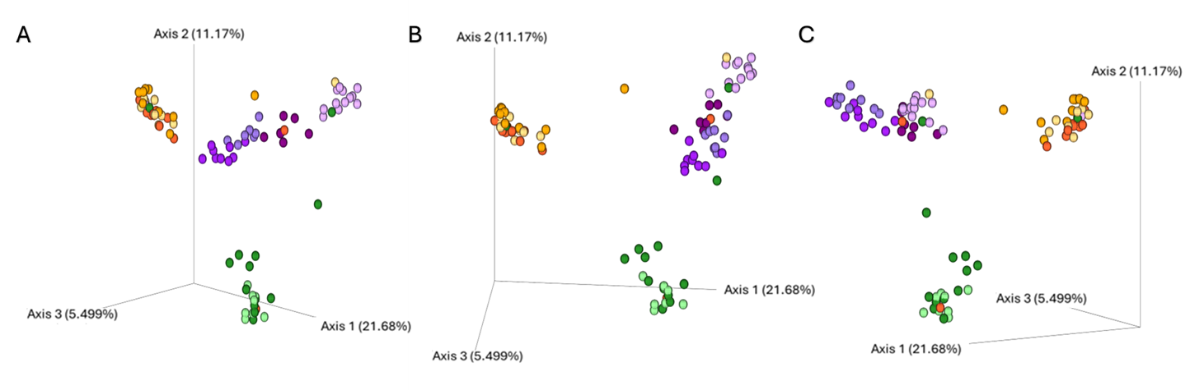
Notes:
Figure S3. Principal Coordinate Analysis (PCoA) of unweighted UniFrac distances from microbial community profiles, shown from multiple perspectives. Panels A, B, and C depict the same PCoA ordination generated using unweighted UniFrac distances, visualized through the emperor software but viewed from distinct angles to provide comprehensive spatial representation of sample clustering. Each point corresponds to an individual sample, and the relative distances between points reflect differences in microbial community composition based on presence or absence of taxa. These alternative views highlight the robustness of sample separation patterns and confirm consistent clustering across multiple dimensions in the ordination space.

Slide 15
